Slide 1
Angular

Slide 2
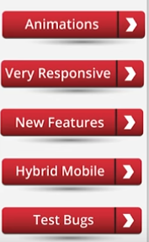
Why Angular

Slide 3
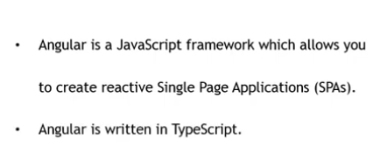
Angular
Angular is indeed a great client-side and open-source JavaScript framework for building interactive components as well as elements of a website

Slide 4
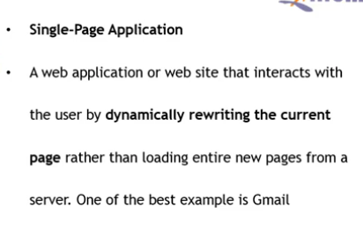
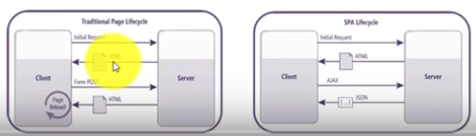
SPA:

Slide 5
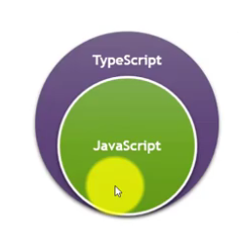
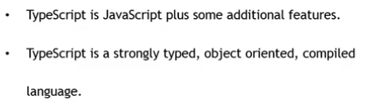
Type Script

Slide 6
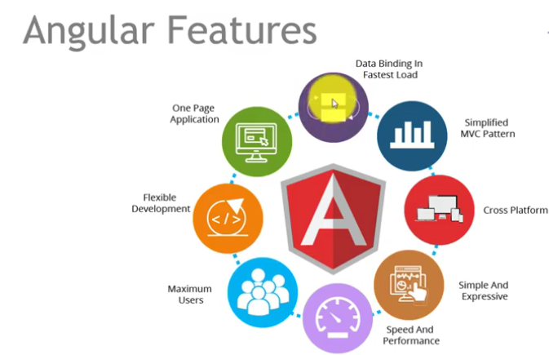

Slide 7
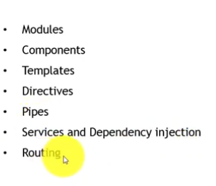
Angular components

Slide 8
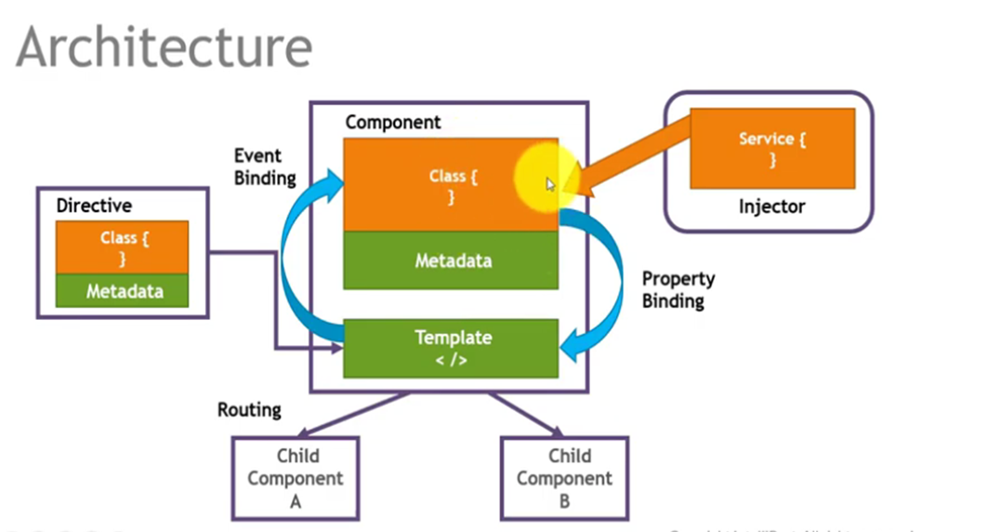

Slide 9
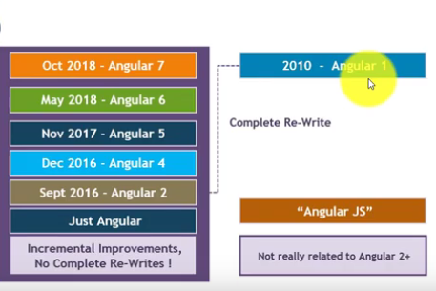
Angular Version

Slide 10
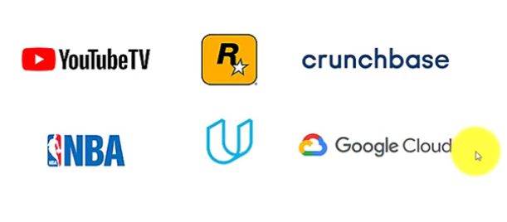
People Using Angular

Slide 11
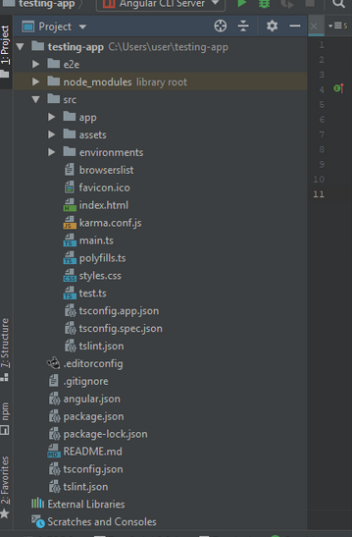

Slide 12
Files used in Angular App folder
Angular App files which are mainly used in your project are given below:
src folder: This is the folder which contains the main code files related to your angular application.
app folder: The app folder contains the files, you have created for app components.
app.component.css: This file contains the cascading style sheets code for your app component.
app.component.html: This file contains the html file related to app component. This is the template file which is used by angular to do the data binding.
app.component.spec.ts: This file is a unit testing file related to app component. This file is used along with other unit tests. It is run from Angular CLI by the command ng test.
app.component.ts: This is the most important typescript file which includes the view logic behind the component.
app.module.ts: This is also a typescript file which includes all the dependencies for the website. This file is used to define the needed modules to be imported, the components to be declared and the main component to be bootstrapped.

Slide 13
One-way databinding
One way databinding is a simple one way communication where HTML template is changed when we make changes in TypeScript code.
Or
In one-way databinding, the value of the Model is used in the View (HTML page) but you can't update Model from the View. Angular Interpolation / String Interpolation, Property Binding, and Event Binding are the example of one-way databinding.

Slide 14
String Interpolation
Property binding
<h4>Property binding</h4>
<h1 [innerHtml]="StudentName"></h1>
Difference between String interpolation and Property Binding
String Interpolation is a special syntax which is converted to property binding by Angular. It's a convenient alternative to property binding.
<h4>String Interpolation</h4>
Name:{{StudentName}}<br/>
Age:{{Age}}<br/>

Slide 15
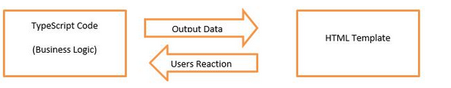
Two-way databinding
In two-way databinding, automatic synchronization of data happens between the Model and the View.
ngModel --achive

